Slide 1

Nexus of Strategic Marketing and Agile Supply Chain
Using PowerBI
-Shantanu Aeer

Slide 2
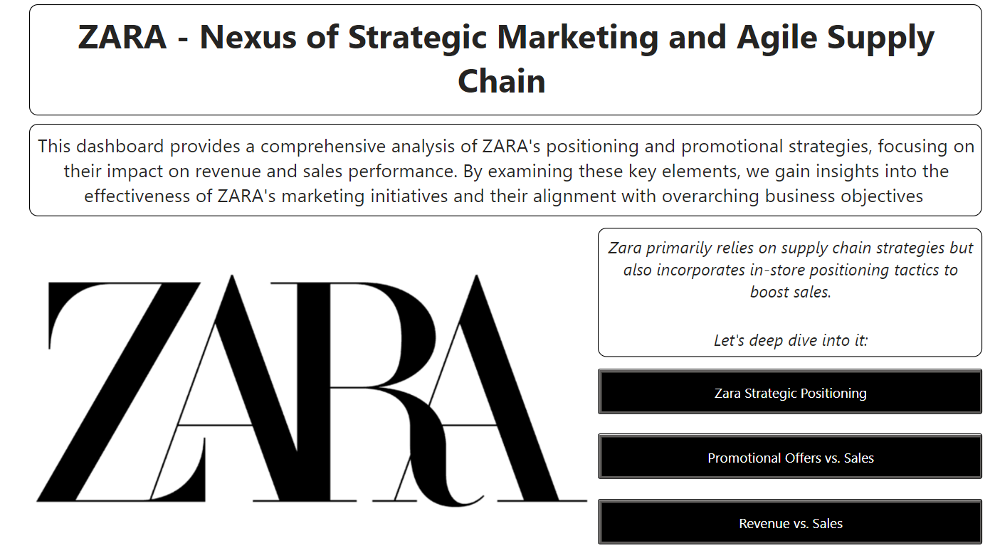

Slide 3
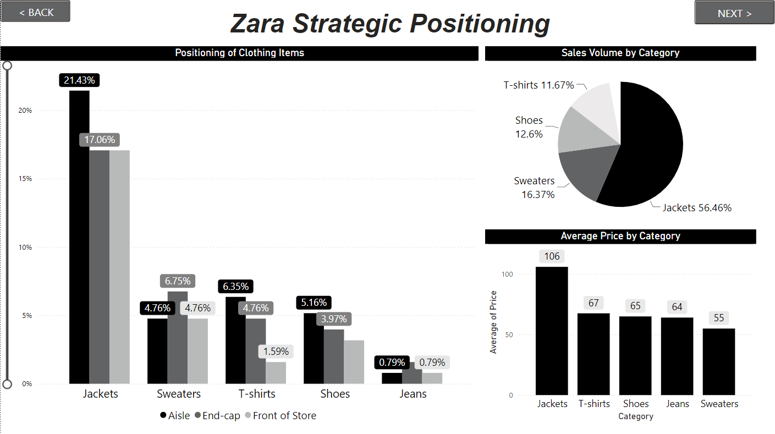

Slide 4
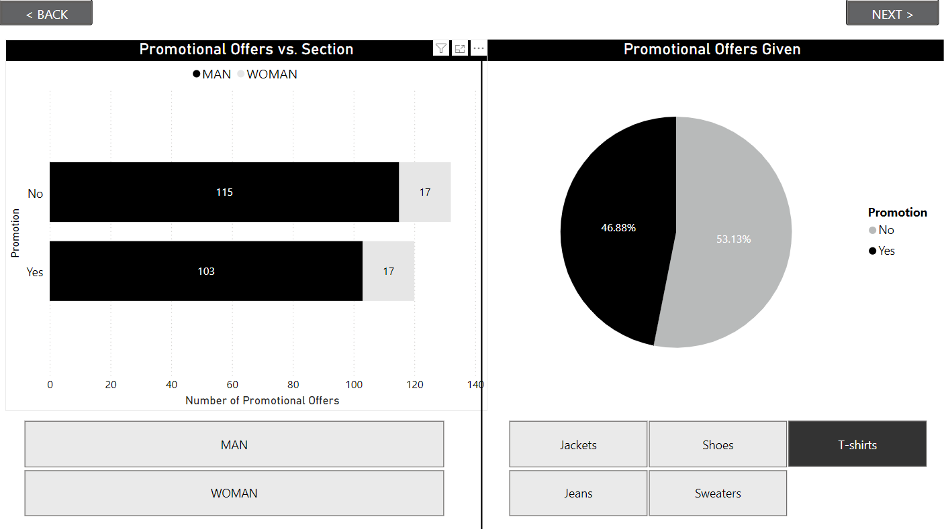

Slide 5
